Slide 1

CUSTOMER FLOW SOLUTIONS
FOR FINANCE – GOVERNMENT – HEALTHCARE – RETAIL - INDUSTRIAL ENVIROMENTS.
Angelo Lupo
2022

Slide 2

The Ultimate Tailored, Intelligent
Customer Flow Solution.
Available architectures of your choice:
Standalone, Centralized or Distributed.
(In Light-Suite-Enterprise versions).

Slide 3

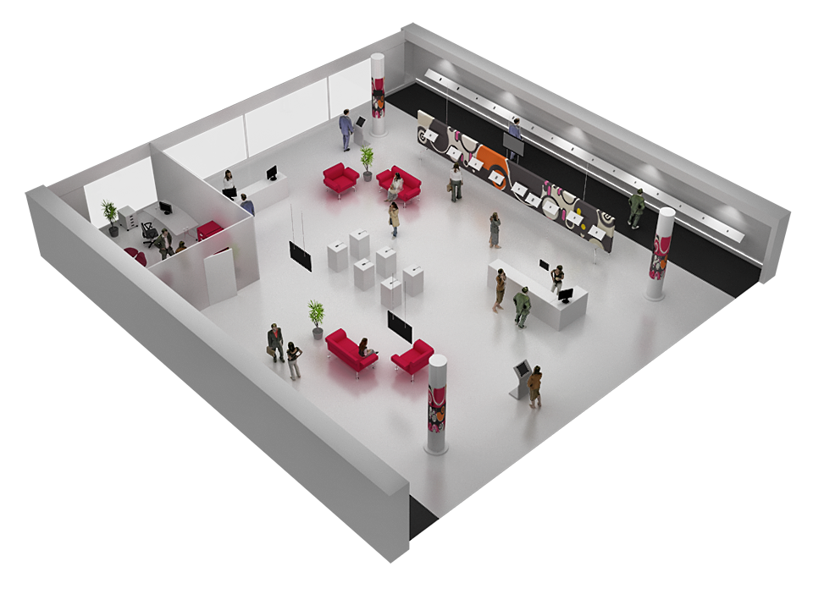






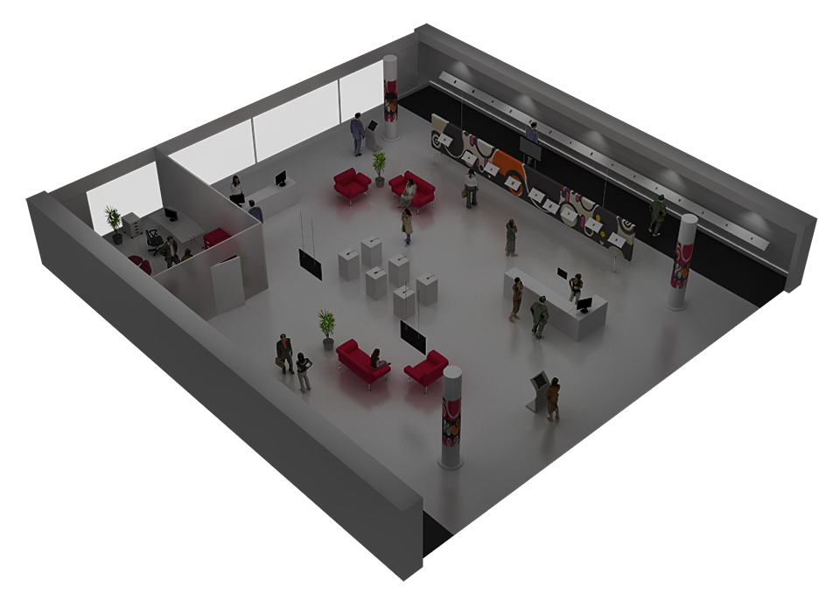
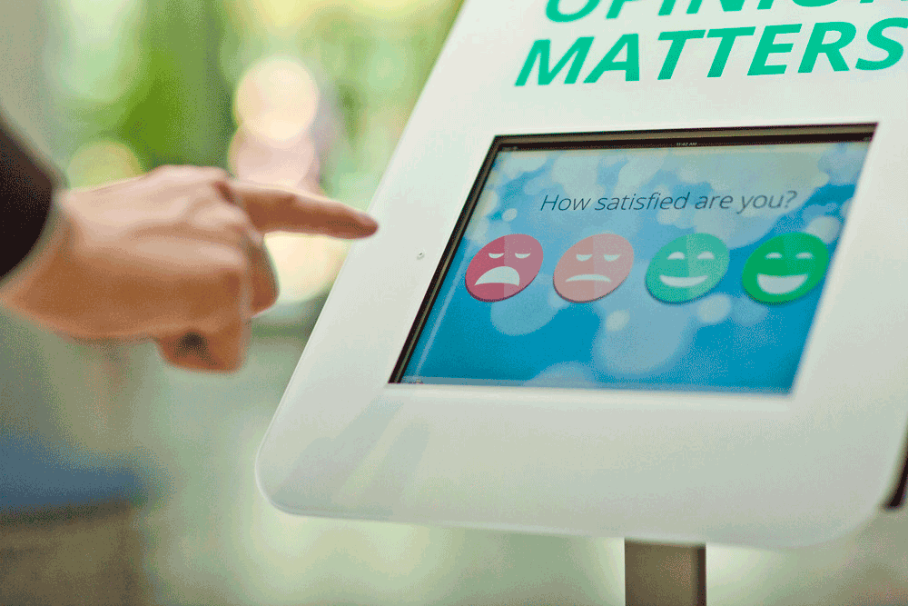
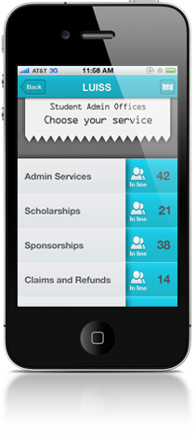

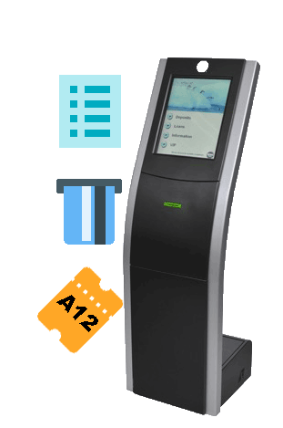

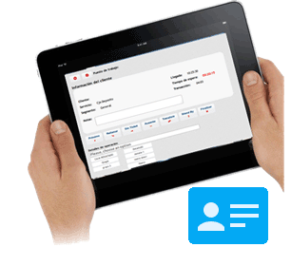


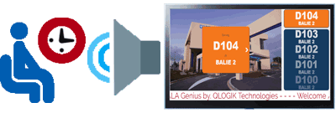

5. Post serving
Customer provides feedback on service experience.
4a. Serving - preparing
Staff is prepared based on identity, service choice and history before service delivery.
1a. Arrival - self service
The customer chooses services matching his needs – gets identified and exposed to instructions, information and ads. Information is sent to the system.
4b. Serving
Customer is called and receives service based on needs, identity, history and staff skills.
3. Queuing and waiting
The customer is informed, entertained and exposed to commercial messages while waiting. Information on when and where to go is carried by the ticket, LED signage, TV monitors and/or pre-recorded announcements.
2a. Arrival - meet and greet
A floorwalker greets the customer and identifies their needs. Information is sent to the system.
1. Pre-arrival
Customer choosing service, or via our appointment or via Geolocator QMOVILITY ADV or E-TICKET (QR) using smarthphone, finding location and reserving a place in the queue. Gets guiding direction, avoid queuing and waiting. Controlled flow of customers.
4c. Serving
Gala QRecording, allow to save a record customer-employee conversation on service to improve performance.
2b. Arrival – Notifications
Receive an SMS / WhatsApp before be attended while enjoy a coffee or shopping outside.
6a. Managing - operational
Supervisors actively manage staff and customers based on alerts and alarms.
6b. Managing
Management control and business improvements based on Management Information (MI) and create your own BI.

Slide 4
Customer Flow Solutions for all Environments
5. Post serving
4a. Serving
6a. Managing - operational
4b. Serving - preparing
6b. Managing
4c. Serving – QRECORDING
3. Queuing and waiting
1. Pre – arrival –QAPPOINTMENT & QMOVILITY ADV OR E-TICKET
2c. Arrival – SMS/Whatsapp
2a. Arrival – self service & Face-Recognition
2b. Arrival – reception

Slide 5
2a. Arrival - self service
The customer chooses services matching his needs – gets identified and exposed to instructions, information and ads. Information is sent to the system.
2b. Arrival - meet and greet
A floorwalker greets the customer and identifies their needs. Information is sent to the system.
3. Queuing and waiting
The customer is informed, entertained and exposed to commercial messages while waiting. Information on when and where to go is carried by the ticket, TV monitors or even LED signage, and/or web recorded announcements.
1. Pre-arrival
Customer choosing service, finding location and reserving a place in the queue via appointment or choosing a Vitual Ticket via Smarthphone service. Gets guiding direction, avoid queuing and waiting. Controlled flow of customers.
4a. Serving - preparing
Staff is prepared based on identity, service choice and history before service delivery.
6b. Managing
Management control and business improvements based on Management Information (MI) and allow you to create your own BI.
4b. Serving
Customer is called and receives service based on needs, identity, history and staff skills.
6a. Managing - operational
Supervisors actively manage staff and customers based on alerts and alarms.
5. Post serving
Customer provides feedback on service experience.

Slide 6
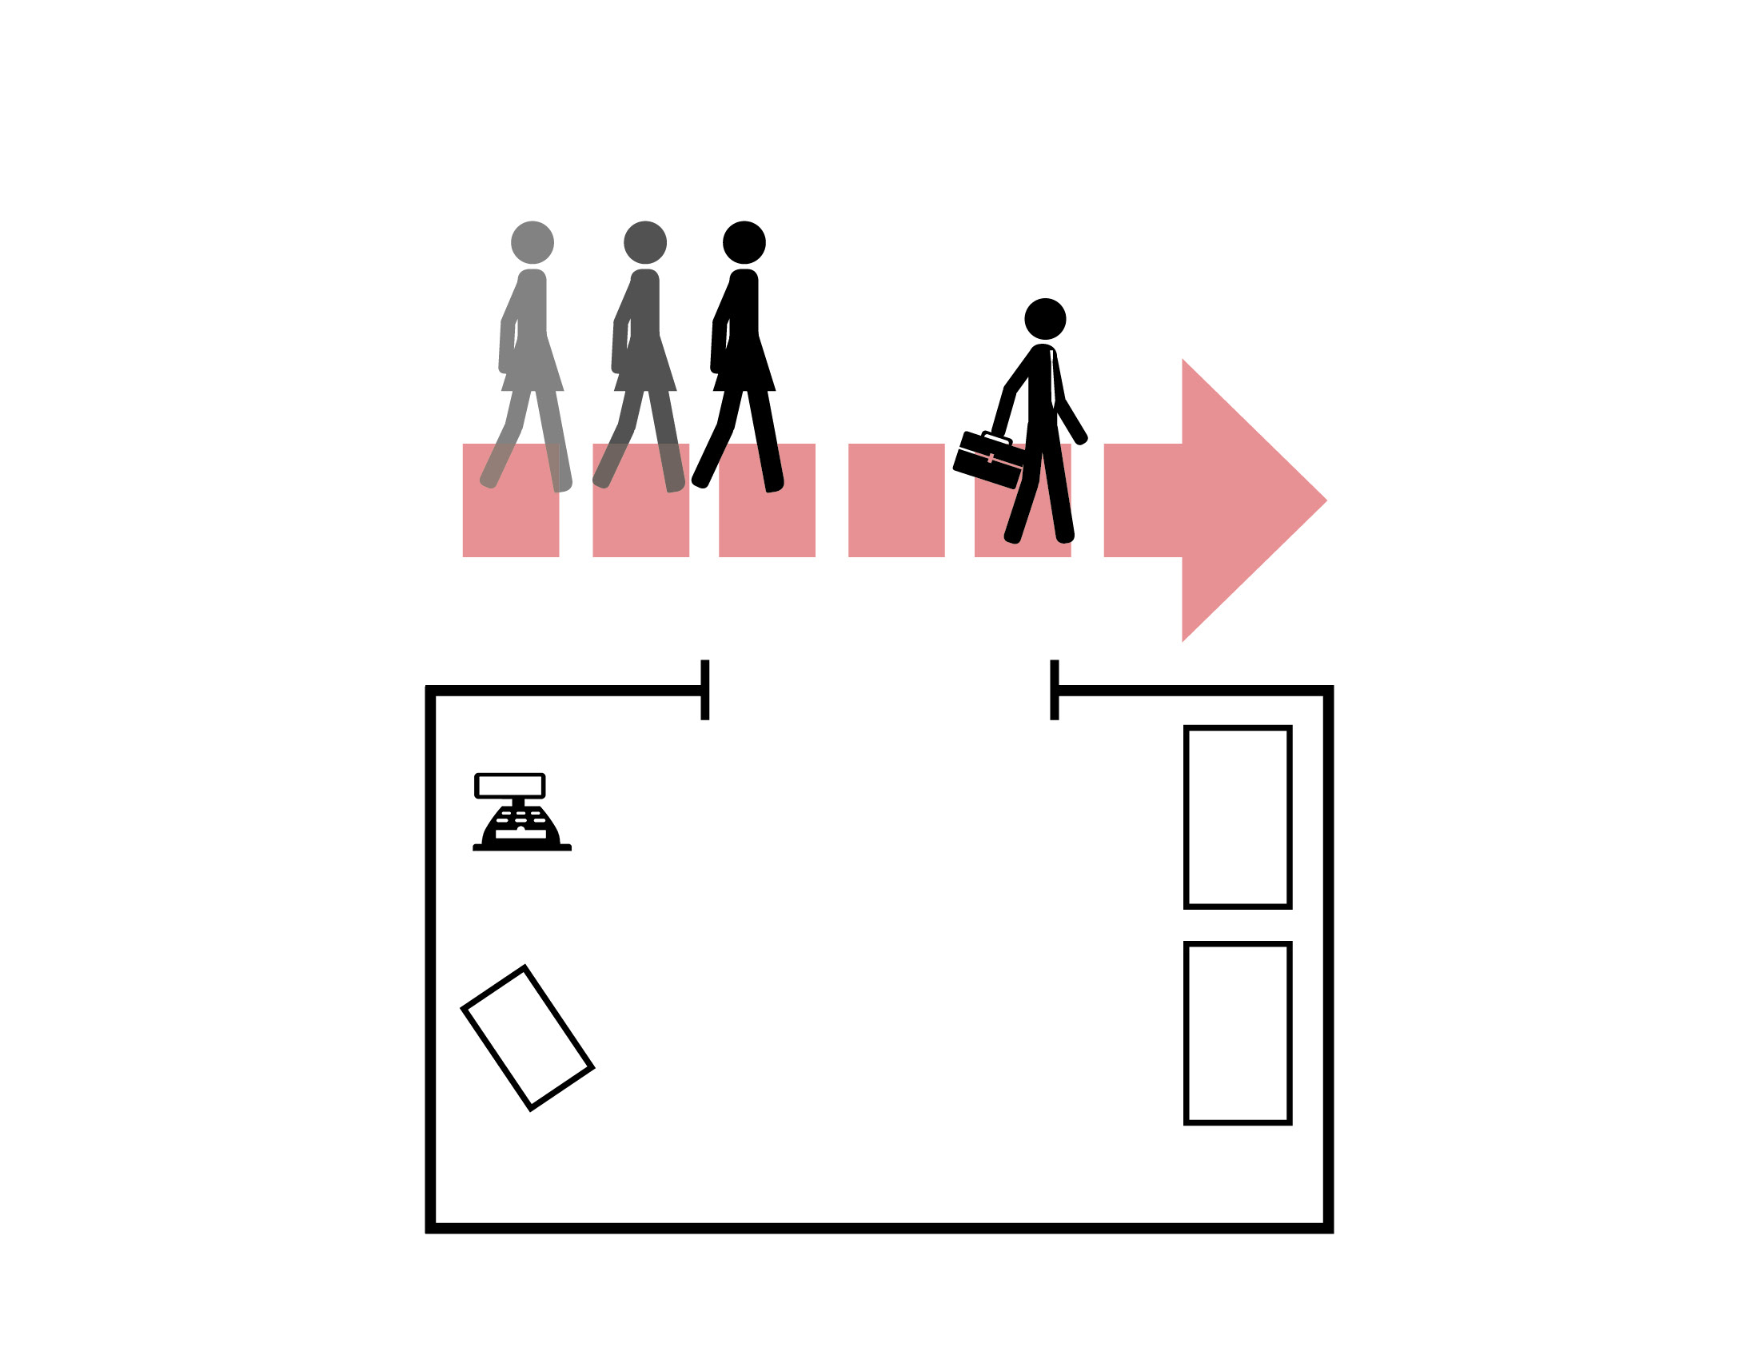
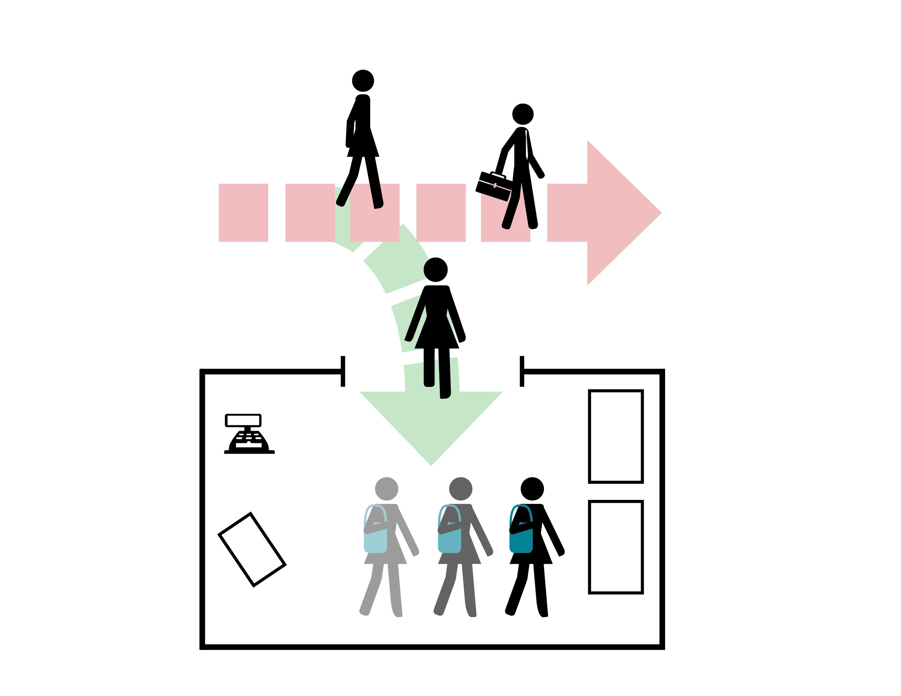
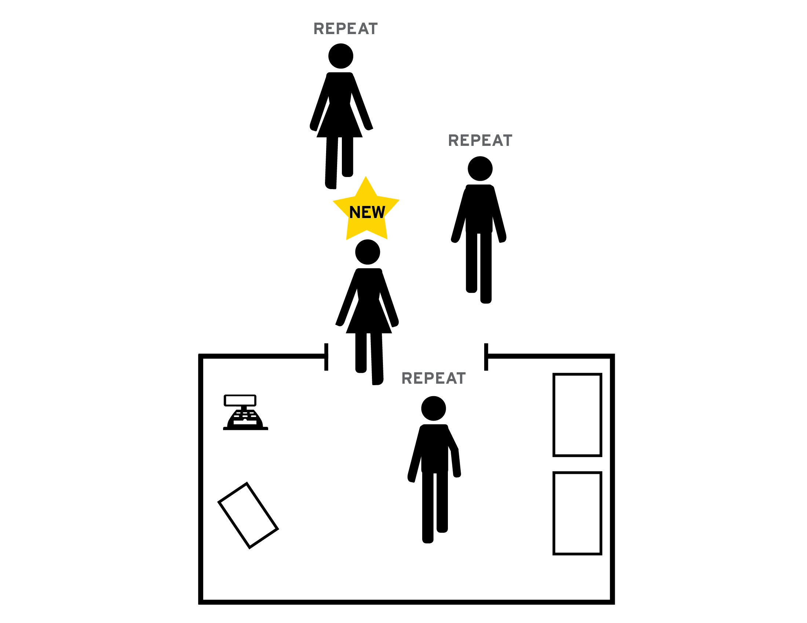
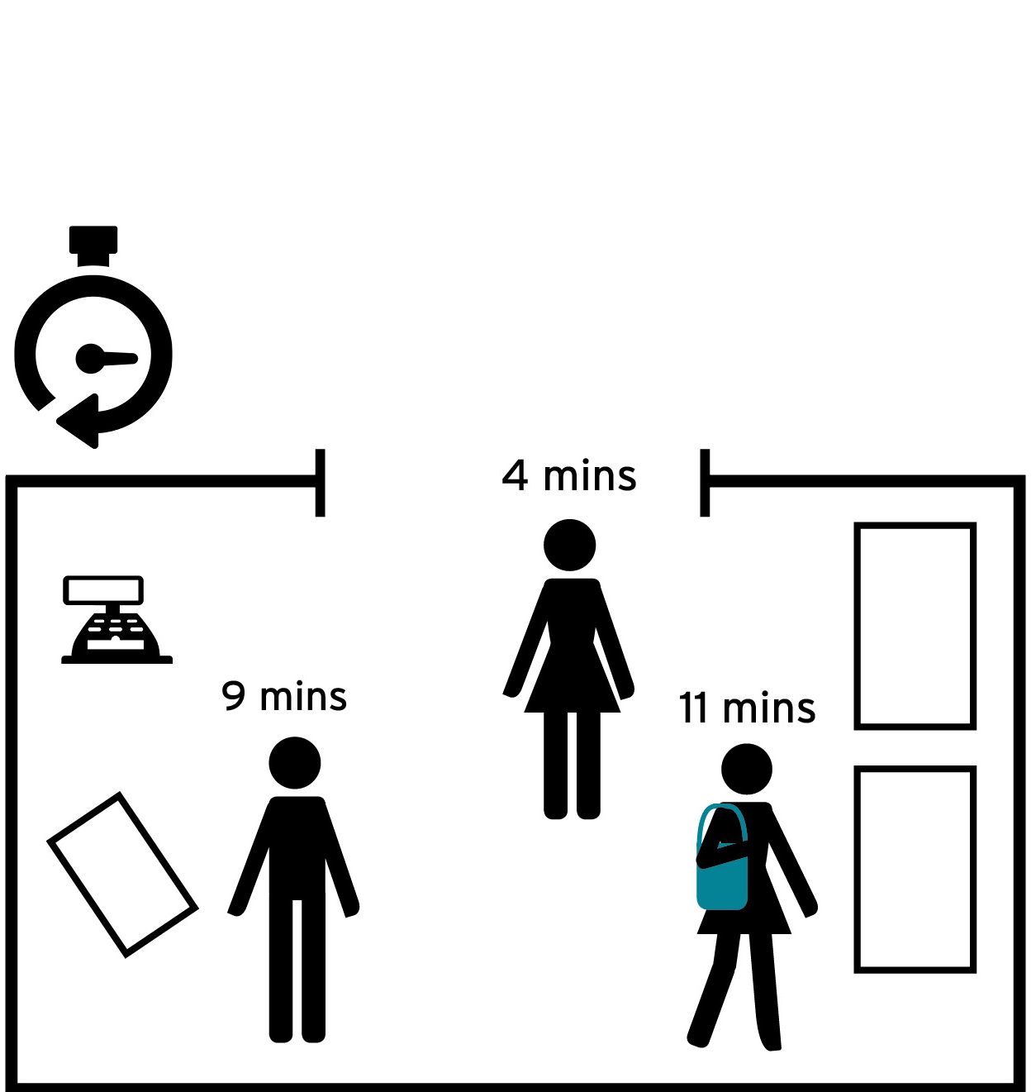
1) Pre-arrival – APPOINTMENT and/or QMOVILITY modules to find out your closer branch and to avoid too long waiting time in queuing on-site
CFS solution
Benefits
Questions
QMOVIILITY (Smart-Mobile) or E-TICKER (QR) Customer visit apps
Integration with third party software solutions
QAPPOINTMENT systems for long term.
Easier access for customer to your clinic
Customers spend optimal time waiting on site (balance long/short)
Client can “move” customers to less busy times to get a more even customer flow and suitable staff levels
Management can plan staffing easier with predictable customer flow
How do your customers find your bank branch closer and fast service?
What is the arrival pattern of customers an ordinary week or day?
Do you know how many customers visit your branches, and when?
How do you know how many staff members you need at a particular time?

Slide 7


Slide 8

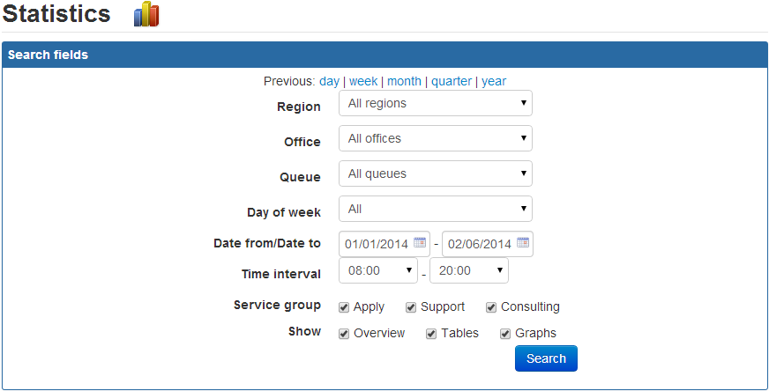
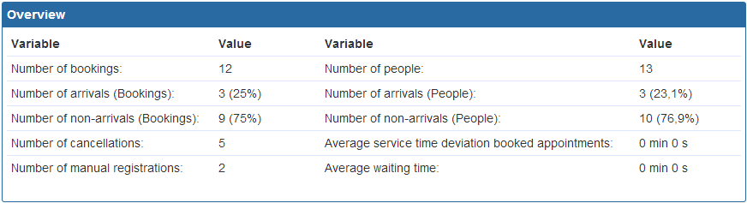
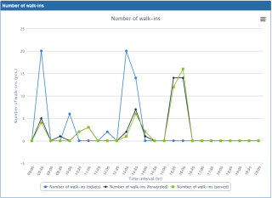
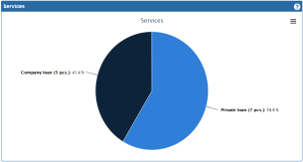
Ventus is an online appointment scheduling software offered by QLOGIK to work hand-in-hand with your existing queuing system or as a stand-alone system. With Ventus, your customers will now be able to schedule, edit, cancel and otherwise manage their appointment experience conveniently online.
QLOGIK will work with your supervisors and management to tailor the Ventus appointment scheduler to fit your needs. With the capability to customize color schemes, and graphics, Ventus is sure to coordinate with your existing webpages. Supervisors will also be able to capture virtually any customer data they wish before customers ever arrive to your office, while also gathering valuable statistics for multiple office locations if needed.
Online
Appointment
Features
Seamlessly blend online appointment and walk-in traffic
Dashboard with realtime walk-in queue status
E-mail/SMS notifications
Captures Customer Data before Their Arrival
Centralized statistics on all appointment vs. walk-in traffic
Customize color schemes and images to coordinate with your existing webpages
Multiple Location Functionality
Export possibilities by e-mail and Excel
Fully open API’s for third party users

Slide 9
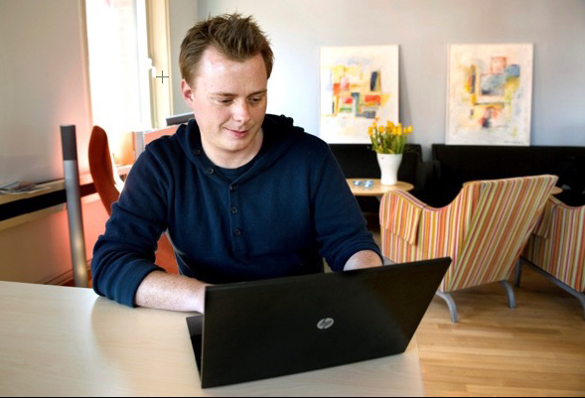
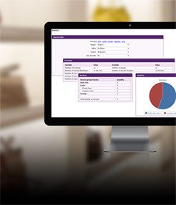
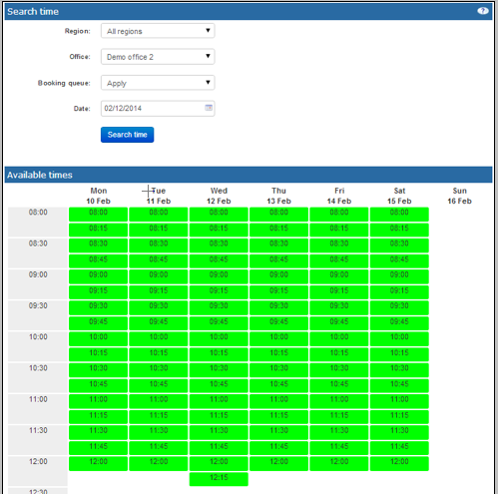
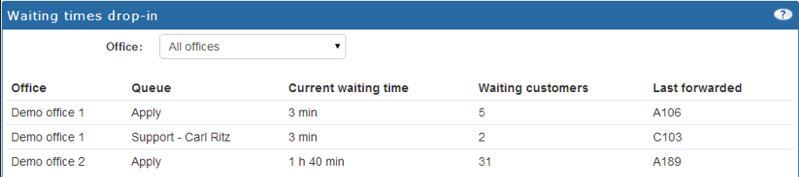
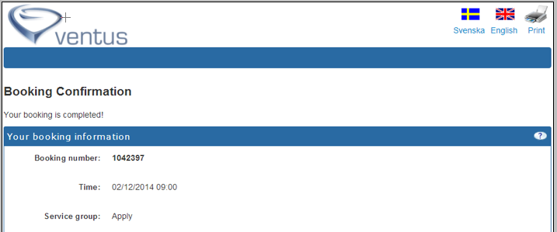

Slide 10




2a) Arrival – Self-Service Kiosk or at reception. Customers may select service to match his needs, can even identified himself and take advance of VIP Service or as smart is possible via Face-Recognition at kiosk.
CFS Solution
Benefits
Questions
Customer service points on Kiosk
Customer use Face-Recognition at Kiosk.
Reception solutions
Floorwalker modules
Ticket printers, SMS/Whatsapp, mini printer and more.
Advertisement - on signage and tickets
Customers receive the information needed to select service
Customers are prepared for the visit – documents needed, general information, promotion
Client knows customers needs
Customers have privacy and confidentiality
Average waiting time reduced
Statistics on customer’s service requests
How do you identify the service request of a customer?
How do you identify a specific customer at arrival, for example a VIP customer?
How do you know when the customer journey starts?
When do you start getting data (Management Information or MI?

Slide 11
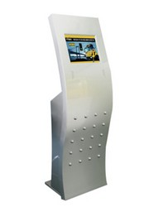
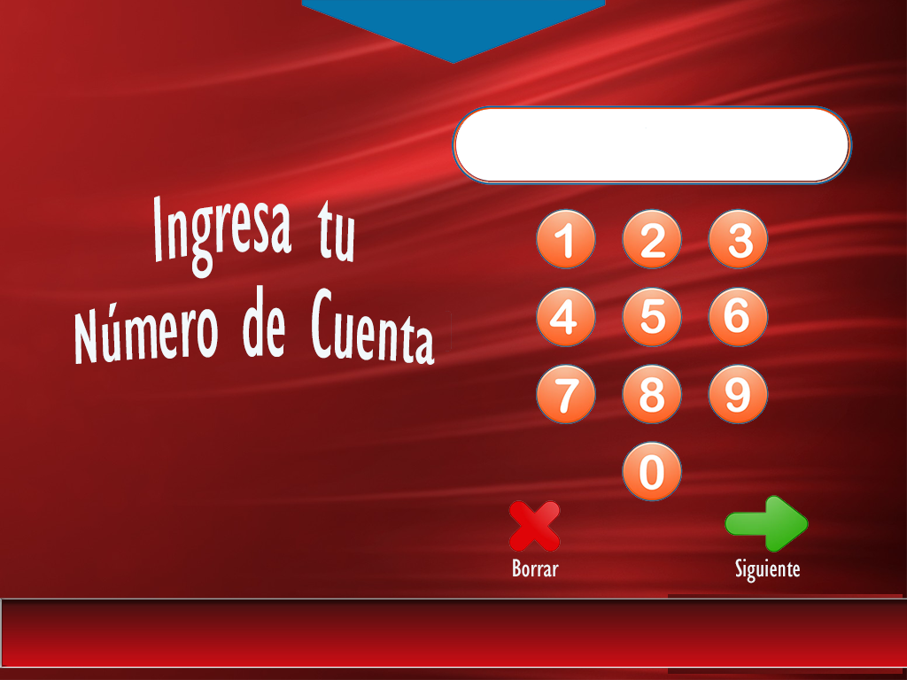
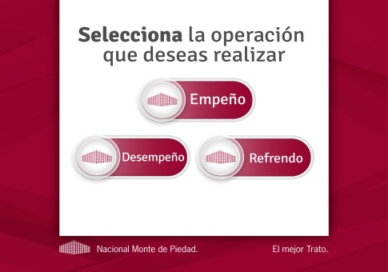
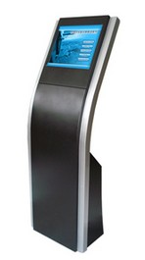
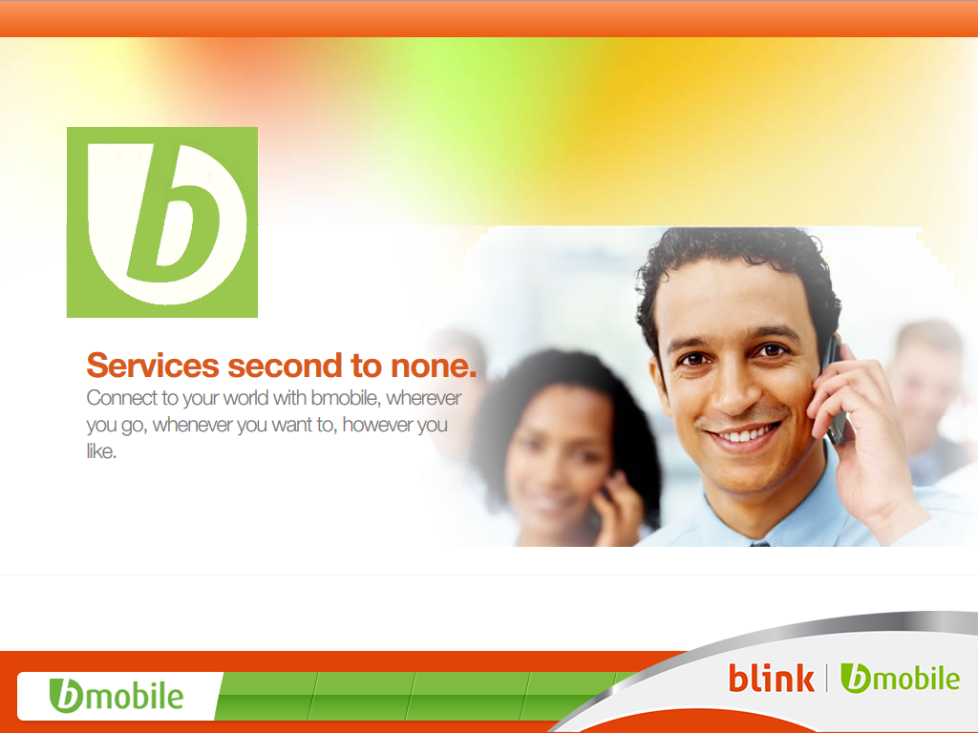
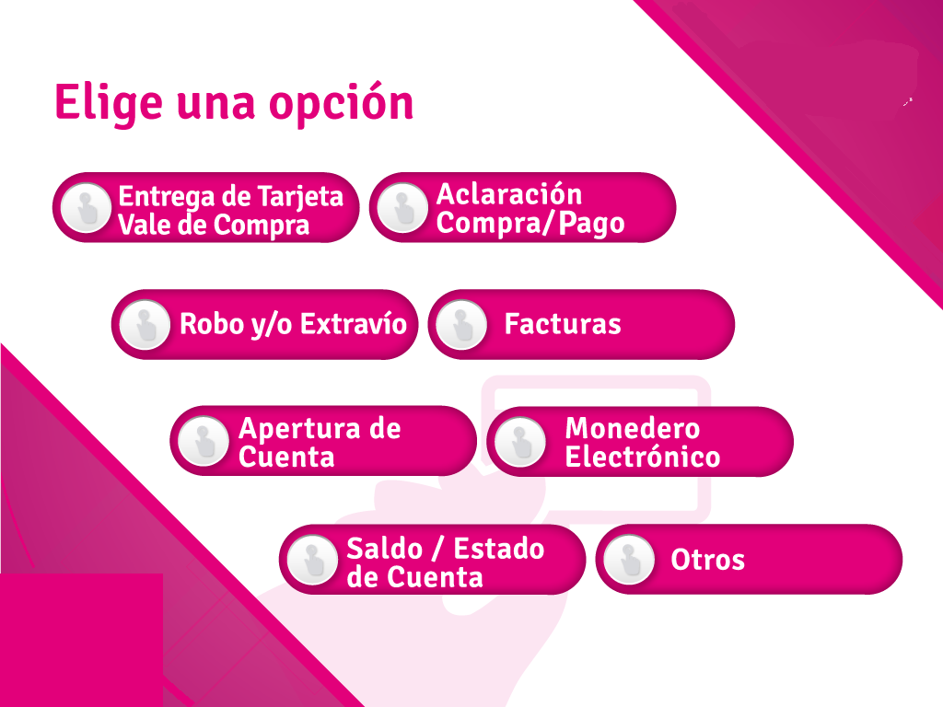
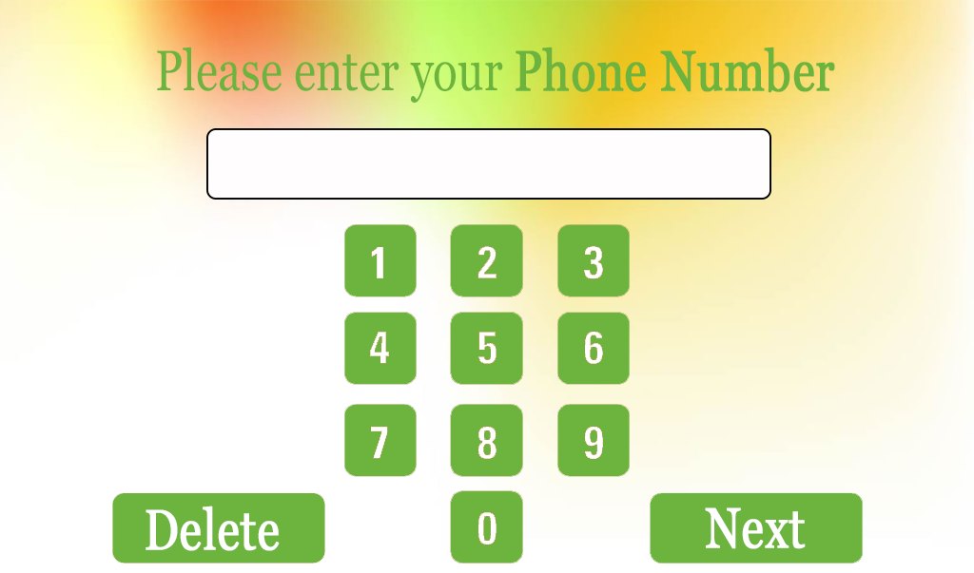
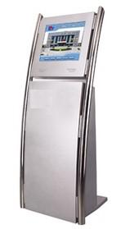
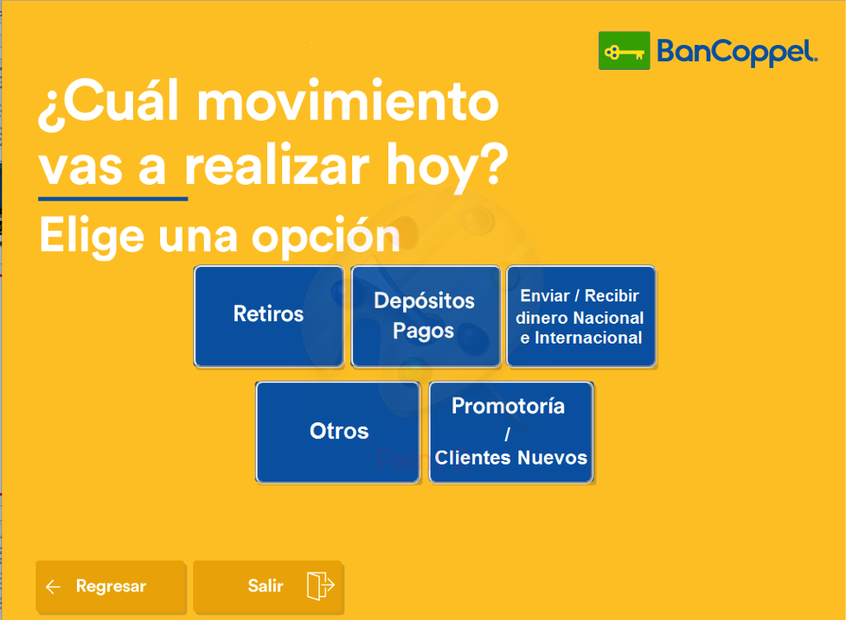

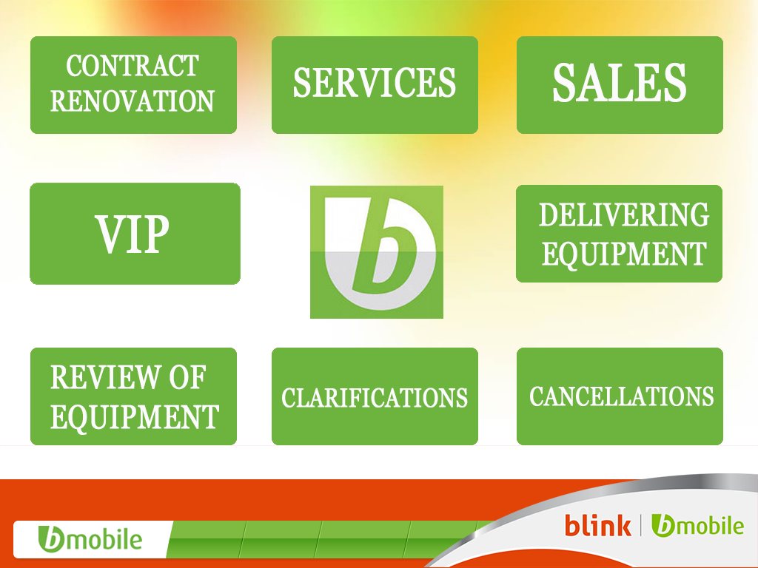

Slide 12
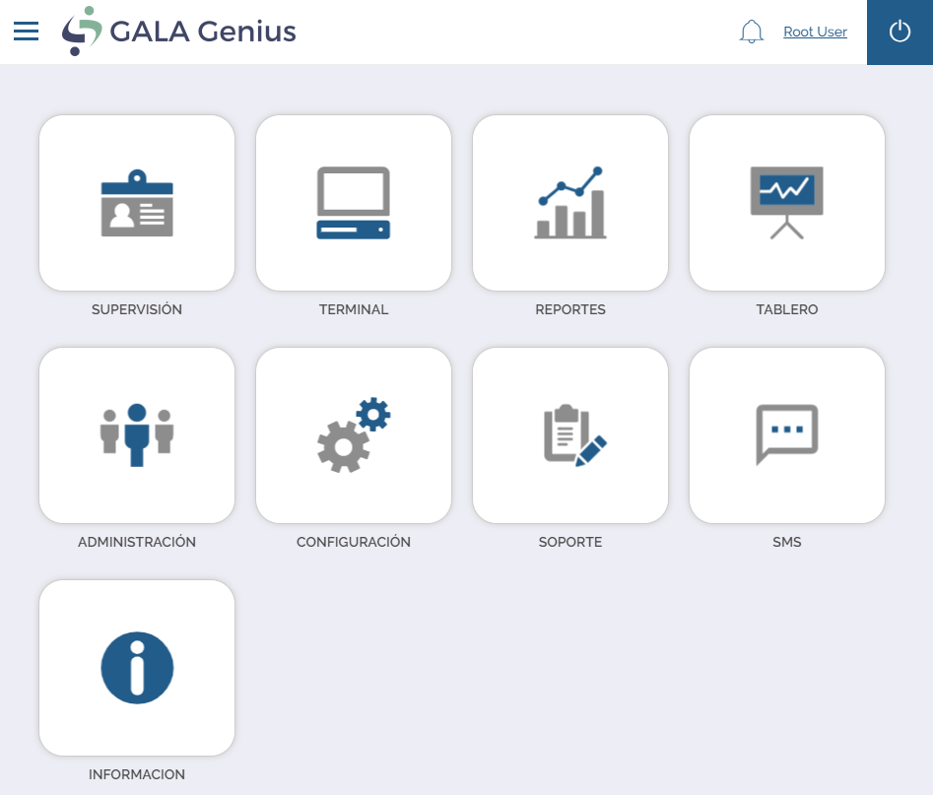

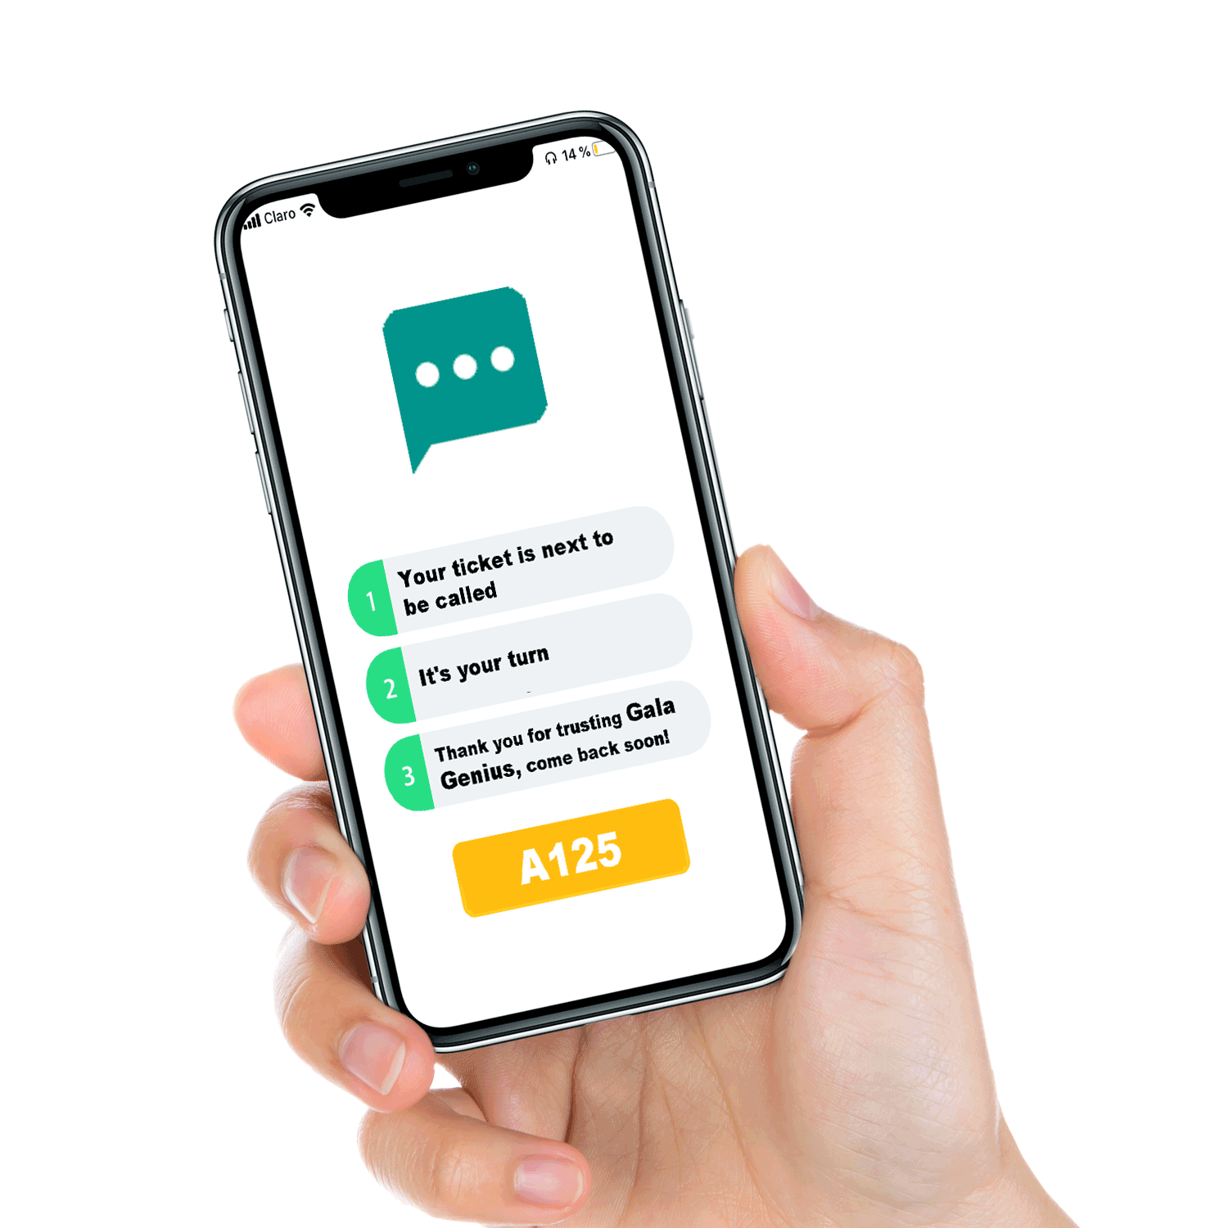
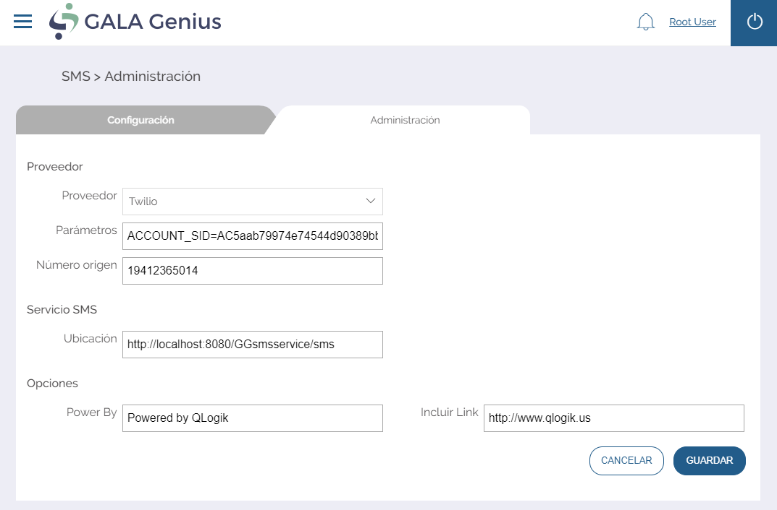
2b) Arrival – NOTIFICATIONS Receive an SMS message before be attended while enjoy a coffee or shopping outside

Slide 13

3) Queuing and waiting – customer is informed and entertained while waiting, receives directions
CFS solution
Benefits
Questions
Inform customers and guide to the correct workstation
Digital media solutions-
queuing information mixed with entertainment and targeted messages to match customers need.
Digital Signage advances
Barriers for teller with sensors
Advertising – on signage and tickets
Voice announcement & messages
Confortable seating.
Customers in general do not need to stand in line waiting
Customer with more privacy
Customer “in process feeling”
Minimised perceived waiting time
Information on when and where to go thru plasmas or LCDs
Prepared customers to reduce service time
Staff satisfaction improved – less stressful environment
Advertise to customers - revenue opportunity
How do you make the queuing fair and logic?
How do you make the customers waiting time a good experience?
How do you make best use of the customer’s time spent in your branches when they are waiting?
How do you inform customers on where and when to go?
How long do customers wait?

Slide 14
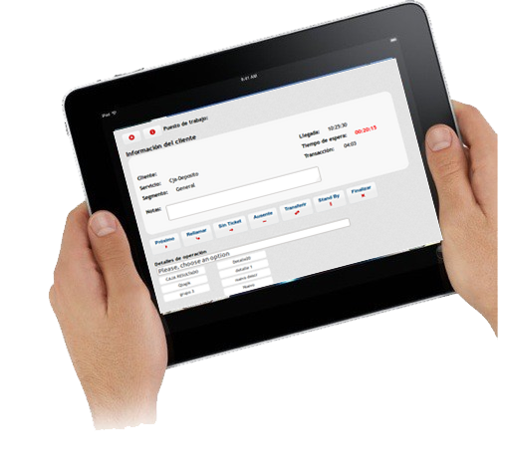
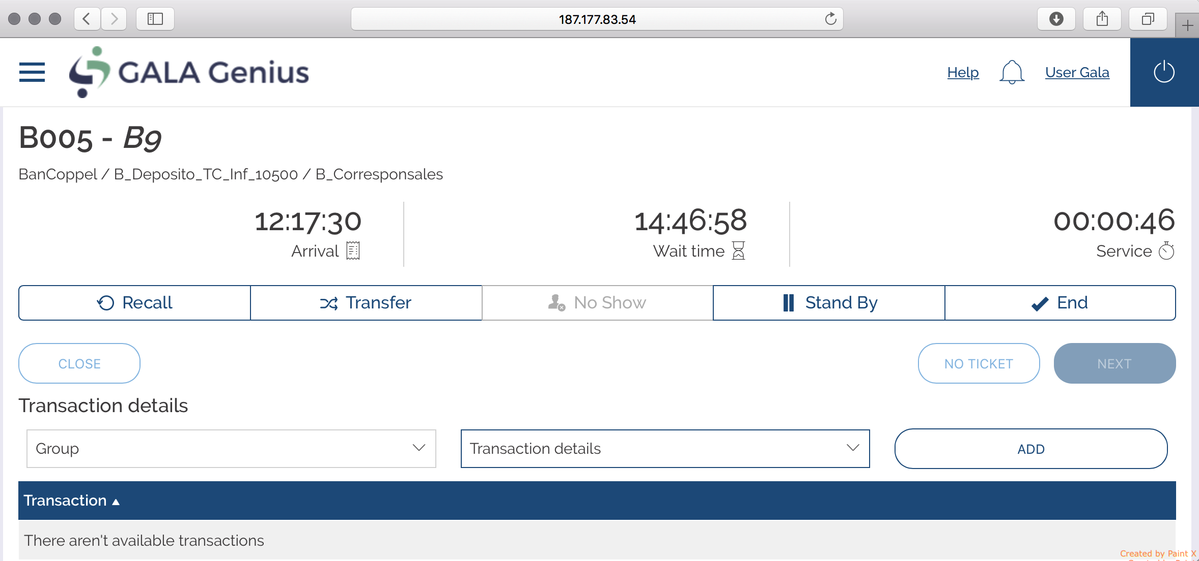
4a) Serving - Staff is prepared based by knowing the need and service history of the customer
CFS solution
Benefits
Questions
Customer history information available for the staff.
Identify customer by name to be more personalized service.
Orientated customer correctly
Measure service satisfaction
Record customer-employee conversation on service provide
Customer service improved through well prepared staff, before serving a customer
Transaction time reduced by having well prepared staff
Staff satisfaction improved through use of core competence
Staff are prepared and can focus on up-sell and cross-sell to generate more revenue
In what way do you prepare staff on a specific customer request?
How do you know the service history of a customer?

Slide 15
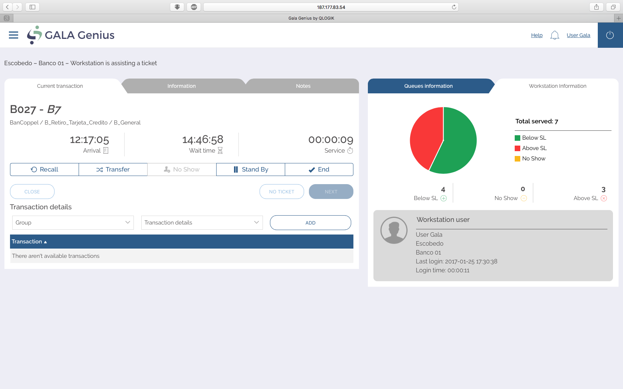

Slide 16
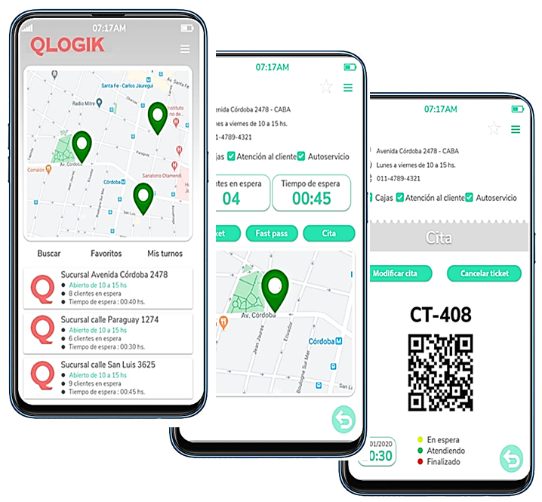
4b) Serving - Customer receives service based on needs and identity
CFS solution
Benefits
Questions
Customer identification
Skilled based routing
Queue optimisation
Signage on where to go
Service point solutions
Greeters catching Customer experience.
Customer service improved through matched service delivery
Staff management improved – needs and skills matched
Staff satisfaction improved through use of core competence
Shorter service time as staff can focus on their core service areas
Staff is prepared and focused on their core service areas – generates up-sell and cross-sell opportunities
Greeters active and in relation with customer experience.
How do you inform customers about where and when to go?
How do you match the best suited staff with the customer’s service requests?
How do you optimise your queues for minimum waiting time?
Is there any value for you in having the best suited staff serving a customer compared to the average staff?
Are the customer experience satisfactory?

Slide 17
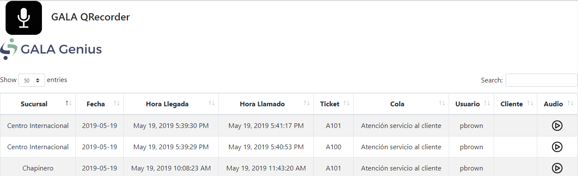
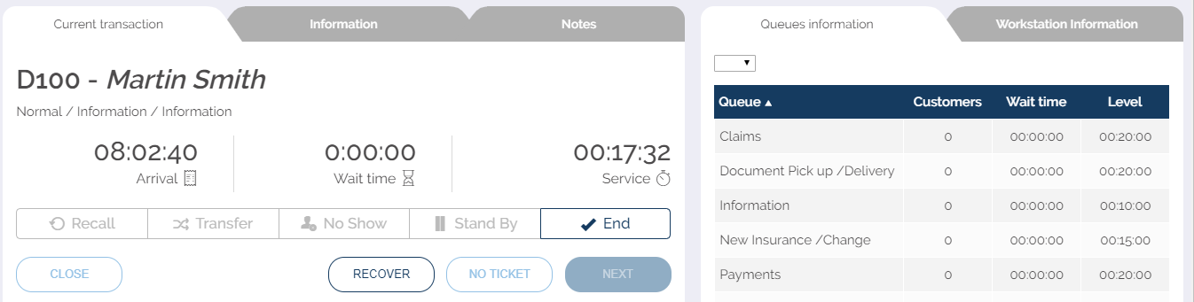
4c) Serving – GALA Q-Recorder an optional software licence used to improve your employee performance

Slide 18
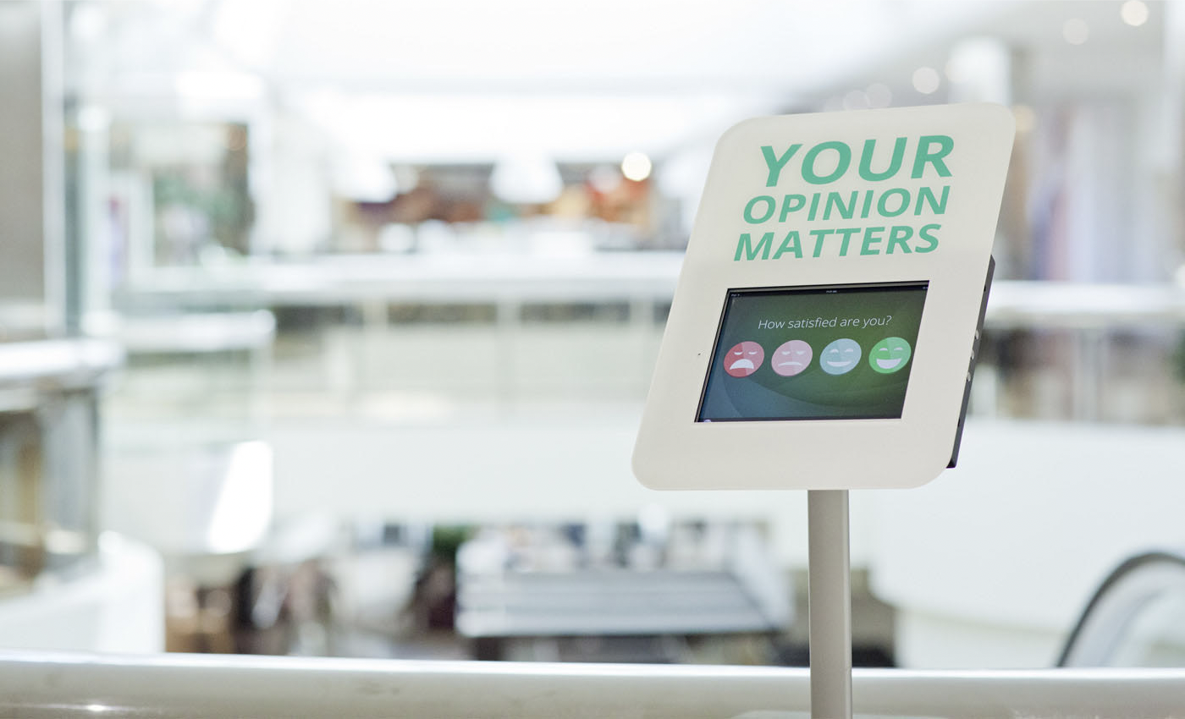
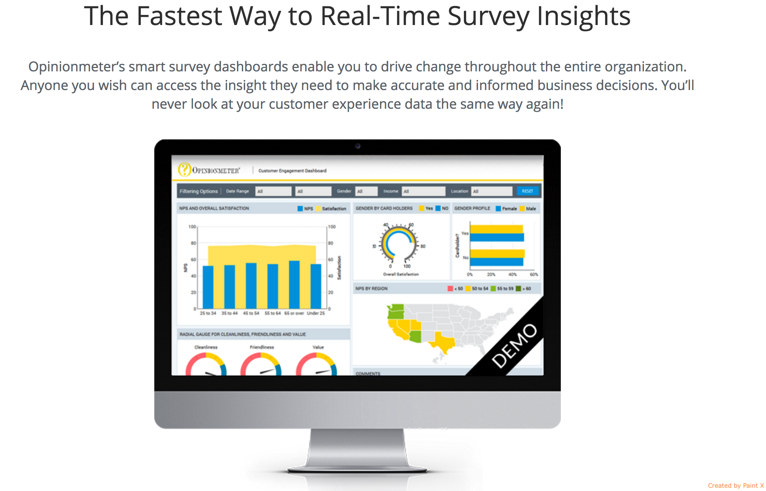
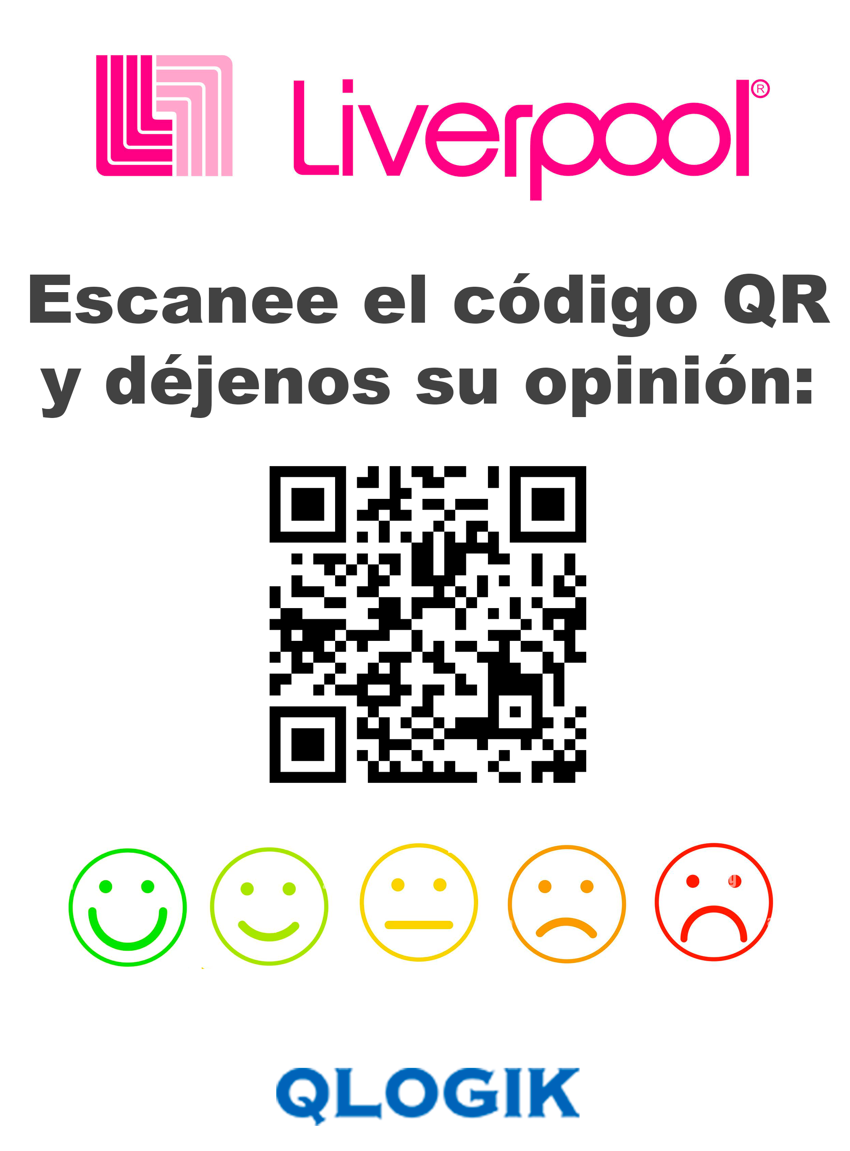
5) Post Serving - customer provides feedback on service experience
CFS solution
Benefits
Questions
Feedback units to provide suggestions and survey to obtain qualitative data on customers perception.
Touch screens for personal survey
Service point (kiosk) for multi use and solutions.
Immediate feedback after the customer received service
Management understanding of what customers really feel and think
Improvement based on knowledge
How do you get feedback on service provided from a customer?
How do you use the feedback information on service experience?

Slide 19
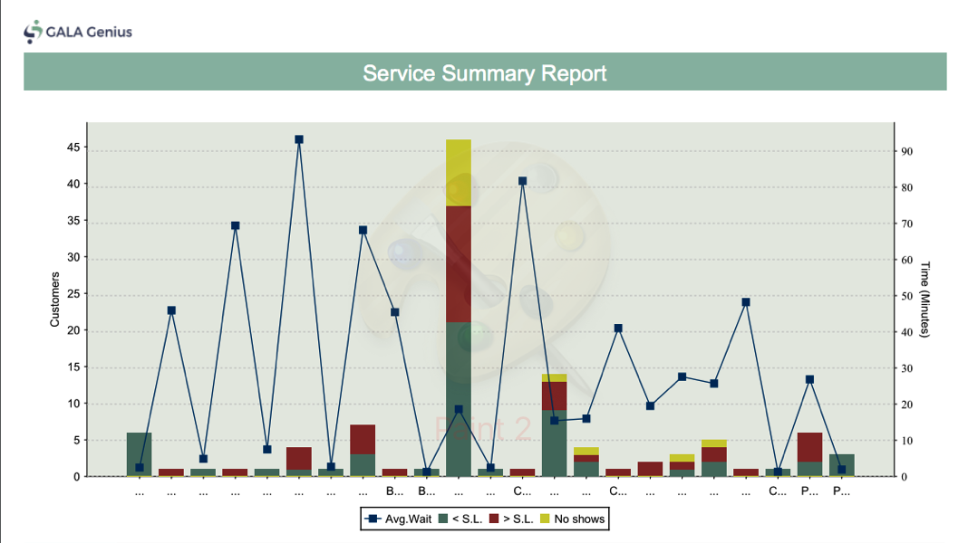
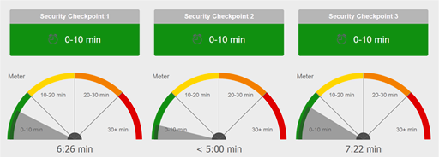
6a) Managing (operational) - supervisors manage staff and customers based on alerts and alarms
CFS solution
Benefits
Questions
Alerts and alarms via email, on-screen pop-ups, displays, monitors or messages thru SMS.
Capture data to analyse customer experience.
Reporting tool
Dashboard application online.
Supervisors provided with an instant view of the situation
Detailed information to reflect daily, weekly, monthly or annual productivity
Supervisors can plan operation and take actions
Shorten average waiting times by active management of staff
Predicting peak times
Improved customers satisfaction
How does the supervisor monitor the service situation?
What KPIs are set and monitored?
How do you predict peak times?

Slide 20
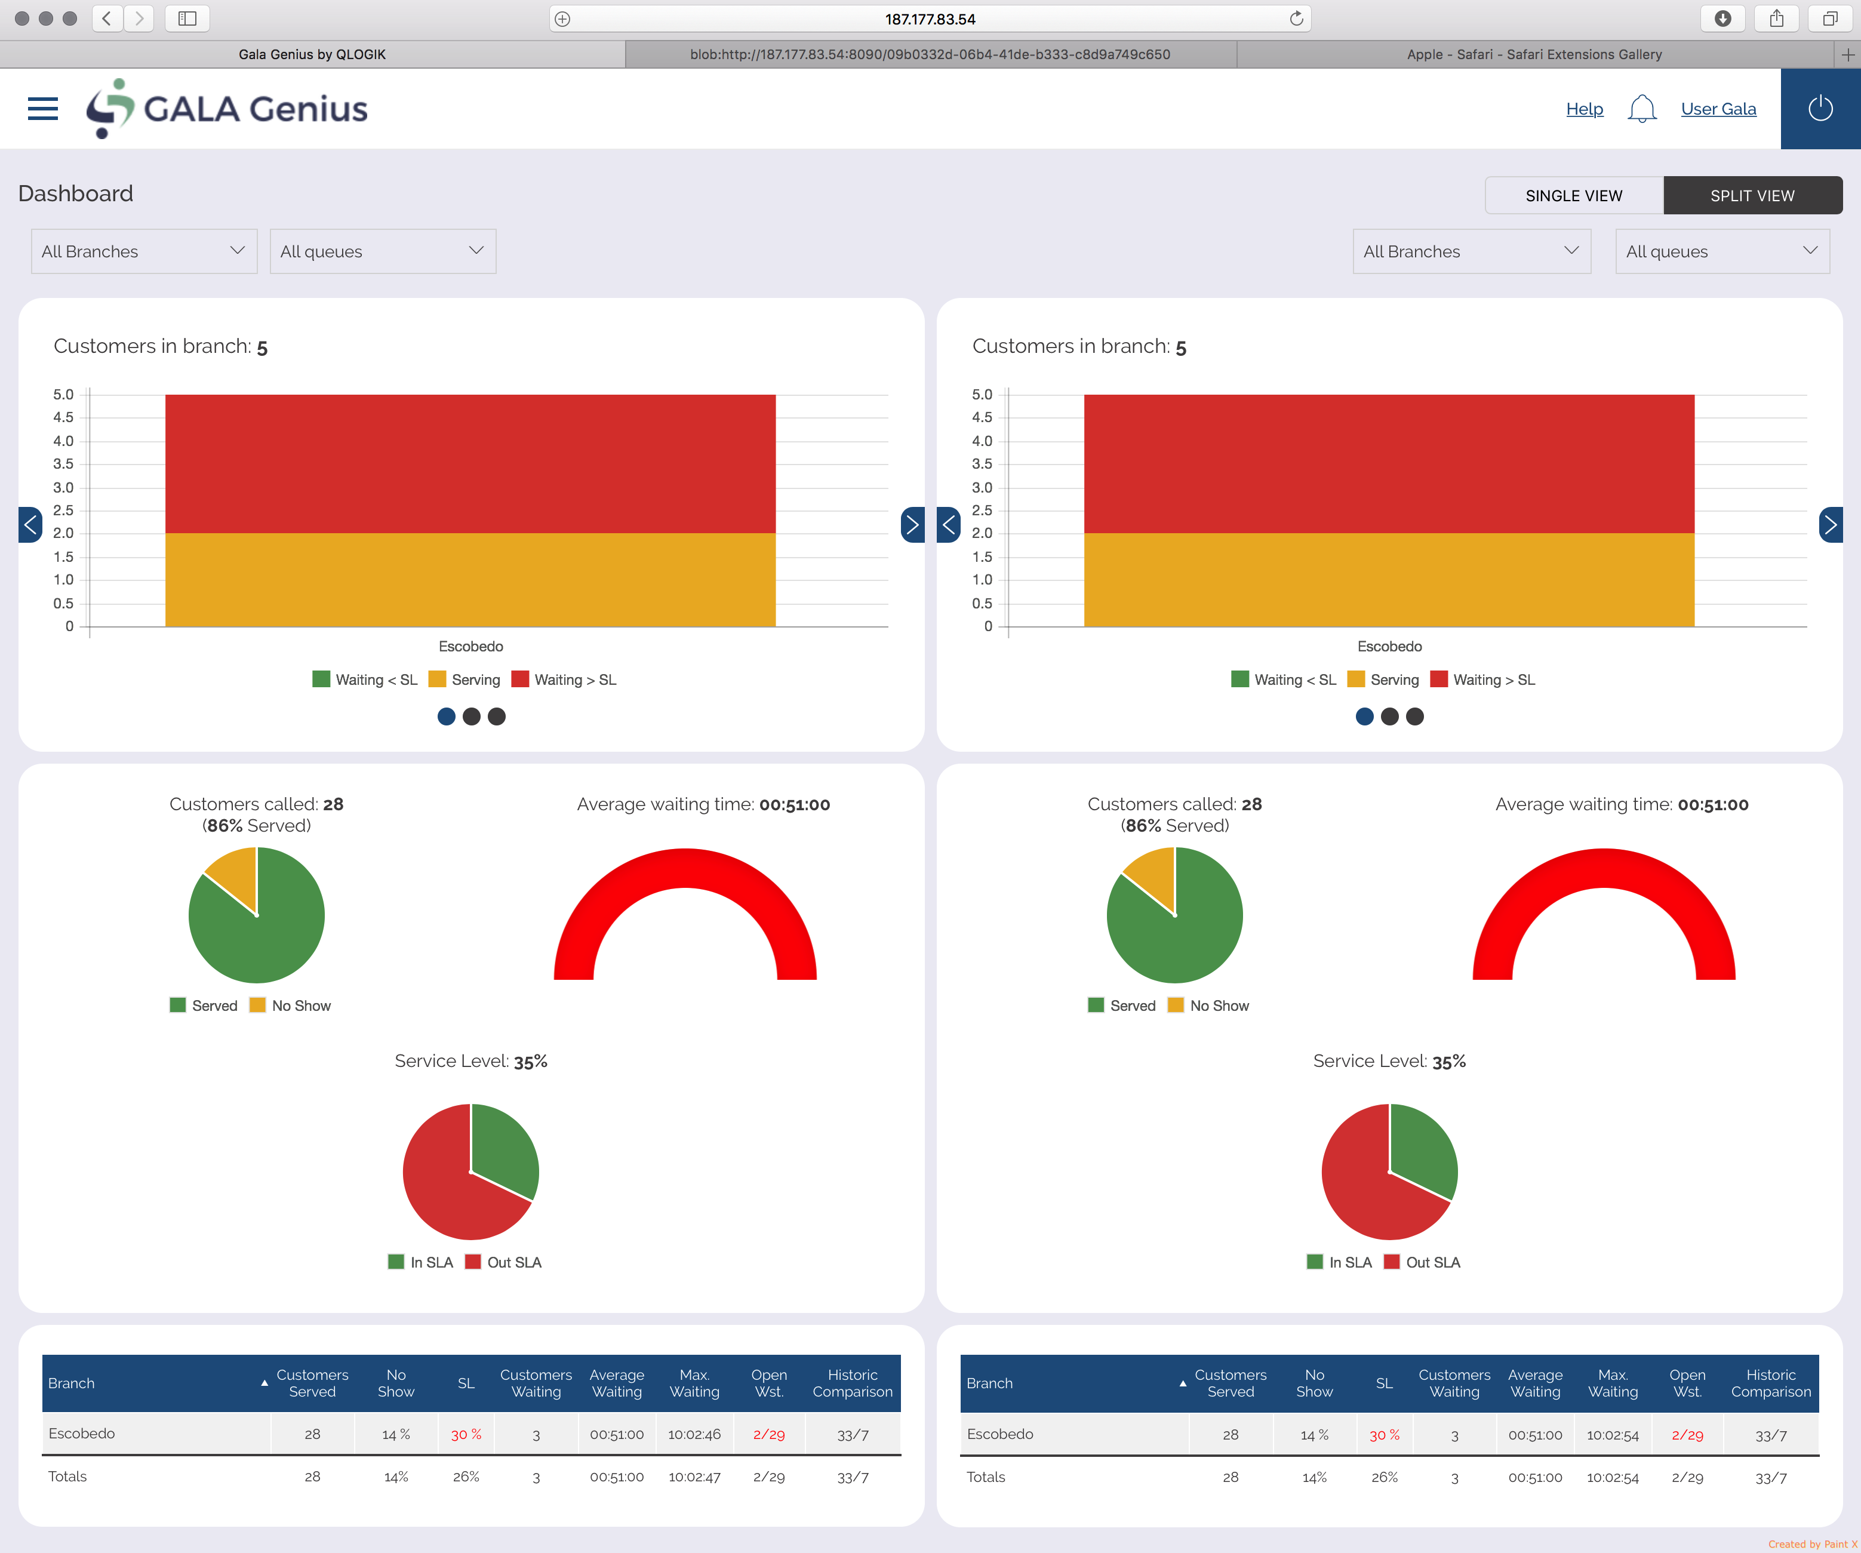
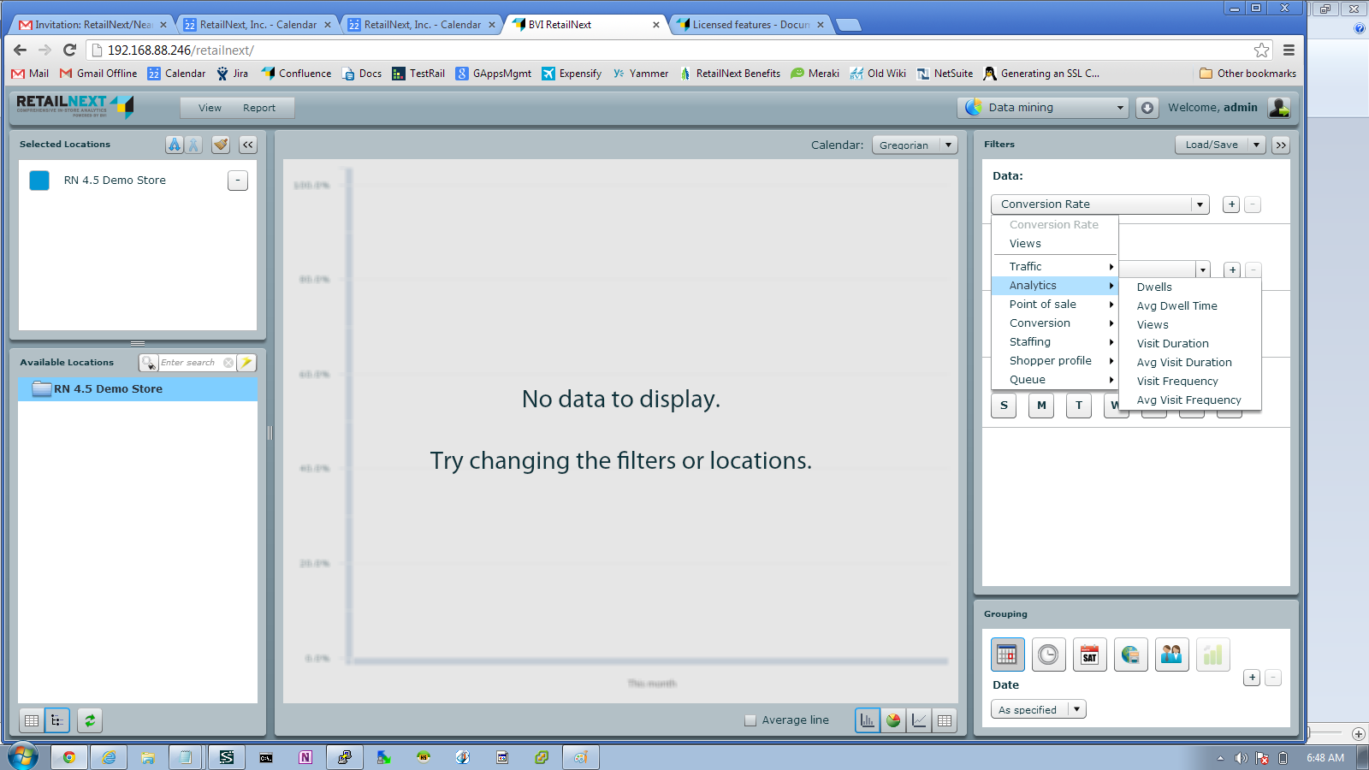
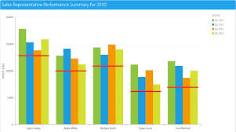
6b) Managing - Control and Improvement based on Management Information (MI)
CFS solution
Benefits
Questions
Tailored statistical reports on service levels – pre planned or on demand
Dashboard applications online
Data mining
Management awareness
Proactive business planning
Improvement based on knowledge from analysis
Benchmarking and operational improvement
Easier KPI setting and reporting per branch and on overall level
Easy access to database to extract data mining for reporting or integration to other application.
Do you know your average waiting and transaction time, transaction cost, staff utilisation and customer volume?
How do you capture and analyse data from your business?
Is the data (if any collected) communicated in the organisation? How?
In what way are you using this to improve operations?

Slide 22


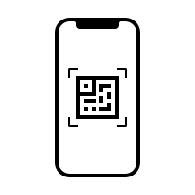






Optional Application Module Description
QAPPOINTMENTis our online web scheduling software created to work integrated and hand-by-hand with GALA Genius system.
QMOBILITY ADV a user friendly tailored app that allow customer to chat or get a virtual ticket to a closer branch via smartphone, saving time in branch.
ETICKET APP also allows customers to take a number by scanning a QR code in with their smartphone without touching any device. Ideal for small branches.
DIGITAL SIGNAGE ADV
This application allow to call customer via your branch TV player, shared videos, messages, advertising and call customer. Keeping customer will informed about branch operation.
Q-RECORDING
This application allow record customer and employee service conversation one its ticket number is called. Record conversation is save on a cloud for easy branch manager access and review service performance.
Q-SURVEY
Or customer Feedback allow all institution to follow up their services receiving from final customers their feedback on service received. Could be done in from or employee, via email or in branch.
SMS/Whatsapp.
Receive notifications of how soon you will be called, directly to your mobile to keep you alert while waiting.
This application work very well integrated with ETICKET or QMOBILITY ADV
Q-RECEPTION
A tailored application for each reception to gathering customer information, personalize attention and avoid using tickets dispensers and keep tracking of customers in site branches.
Q-APPOINTMENT
QMOBILITY
ETICKET
SMS /
Whatsapp
Q-RECEPTION
Digital
Signage
Q-RECORDING
Q-SURVEY
C O N F I D E N C I A L

